Slide 1



Kotlin Programming
This Photo by Unknown Author is licensed under CC BY-NC
This Photo by Unknown Author is licensed under CC BY-SA

Slide 2
Overview
Kotlin – open source programming language
Created by JetBrains
JVM language
Can call java code and vice versa
Official Android programming language
IDE : IntelliJ IDEA (Community Edition)
https://play.kotlinlang.org:
Semi-colons not required.
Required only when multiple statements are used in same line

Slide 3

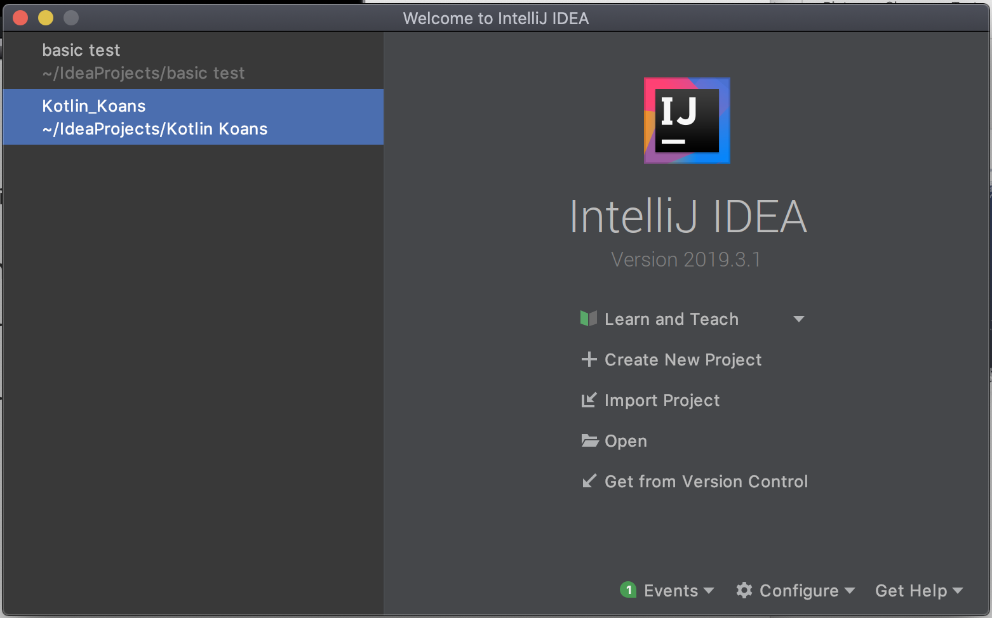
First Kotlin application
All projects created will be listed here. If none this area is empty.
Click here to create new project

Slide 4
Creating Kotlin app
For practicing Kotlin programming we use Kotlin/JVM option
Give name of your project and follow onscreen instructions to create the project.
Similar to Java use src folder to store your source files.
Create a Kotlin file and store it under src folder
File extension is .kt

Slide 5
Hello Kotlin code
Program entry point
fun is a keyword used to denote function
main is name of function
Function accepts array of strings and name of array is args
println -> command to print new line
Semi-colons not required
Needed if you have multiple statements in same line
Parameters goes inside the parenthesis
fun main(args: Array<String> ) { println("Hello Kotlin") }
Function body (Your code goes here)

Slide 6
Running Kotlin app
Use Run command in Run menu
IDE compiles the code into JVM byte code
Creates class file
IDE starts the JVM and executes the .class file or files
REPL stands for Read-Eval-Print Loop
It allows you to quickly run some code without main
Available under the Tools menu

Slide 7
Basics
Keyword var or val is used to create variable (mutable and immutable)
In kotlin variable holds the reference to the object
Cannot be changed if variable is created using val
Data types - objects
Byte, Int, Float, Double, Booleans, Characters and String
long value requires the suffix L and a float, the suffix F
If you don’t specify data type compiler decides the variable type
var x = 5 (Type inference)
var num : Int (Type annotation)
If wrong value is assigned to a variable code will not be compiled
Statically typed language
You cannot assign one type variable to other type

Slide 8
Basics
Data types are objects
Each of data types have special functionality
Accessed using dot operator
val myString = "The quick brown fox"
val uppercase = myString.toUpperCase()
To convert variable to other types use dot operator
var z : Long = x.toLong()
Make sure when you try to force conversion of variable to other type it fits
Values cannot be null
Val name: String? = null
Late Initialization
non-null types need to be initialized when they are declared
lateinit modifier
lateinit var myName: String
myName = “Jane”

Slide 9
Basics
Strings
val name=“Jenny”
val string = “my name is $(name)”
Use “”” to create a raw string
No escape characters needed
val message = """You have 10 new messages,
5 old messages
and 6 spam messages.""".trimMargin()
toUpperCase()
myString.length
myString.contains(”test")

Slide 10
Basics
Nullable type
provide a safe and consistent approach to handling situations where a variable may have a null value assigned to it.
val username: String? = null
if (username != null) {
val uppercase = username.toUpperCase()
}
safe call operator (represented by ?.):
val uppercase = username?.toUpperCase()
Comments
Same as java -> single line // and block /* */
Packages and import
import com.packt.myProject.main
Renaming import
import com.packt.yourProject.main as yourMain

Slide 11
Basics
Operators
Arithmetics operators
Augmented assignment operators
X+=y, x*=y etc
Increment and decrement operators
Equality operators
Logical operators
Range operators

Slide 12
Basics
Bitwise operators
BitwiseAND
BitwiseOR
BitwiseXOR
BitwiseInversion
Bitwise Leftshift and Bitwise Rightshift
Arrays:
To group multiple data of same type
var scores = arrayof(23,45,50)
(1..10).toList().toTypedArray()
IntArray(5, { i -> i * 2 + 3})
To create array you use arrayof() function
Index starts with 0
Use .size property to get size of an array

Slide 13
Basics
Ranges
Use .. Operator
val alphabets = “a”..”z”
Use in operator to test if a value is in the range
val isC = “c” in alphabets
downTo() creates range counting down
rangeTo() will create a range up to a value
To modify delta between successive terms in range we can use step()
val tenToOne = 10.downTo(1)
val oneToTen = 1.rangeTo(10)
val odd = oneToTen .step(2)

Slide 14
Basics
Control flow
If .. else
In Kotlin if else can be used as part of expression
val date = Date()
variable = if (condition) return_val_1 else return_val_2 val today = if (date.year == 2016) true else false
if (x == 10) println("x is 10")
else if (x == 9) println("x is 9")
else if (x == 8) println("x is 8")
else println("x is less than 8")

Slide 15
Basics
When can also be used as expression similar to if else above
when (value) {
match1 -> // code to be executed on match
match2 -> // code to be executed on match
.
else -> // default code to executed if no match
}
fun whatNumber(x: Int) {
when (x) {
0 -> println("x is zero") 1 -> println("x is 1")
2,3,4,5,6,7,8,9 ->(”x is digit”) else -> println("X is neither 0 or 1 or digit")
}
}
Constants can be combined if the branch code is the same

Slide 16
Basics
For..in statement
for variable name in collection or range {
// code to be executed
}
for (index in 1..5)
for (index in "Hello")
for (index in 100 downTo 90)
for (index in 1 until 10)
for (index in 0 until 100 step 10)
{
//Do something with $index
}

Slide 17
Basics
Loops
while (true) {
println("This will print out for a long time!")
}
val list = listOf(1, 2, 3, 4)
for (k in list) {
println(k)
}
val set = setOf(1, 2, 3, 4)
for (k in set) {
println(k)
}
Loops
val oneToTen = 1..10
for (k in oneToTen) {
for (j in 1..5) {
println(k * j)
}
}
for (index in array.indices) {
println("Element $index is ${array[index]}")
}

Slide 18
Basics
Break
Continue
Break and Continue Labels
outerloop@ for (i in 1..100) {
println("Outer loop i = $i")
for (j in 1..100) {
println("Inner loop j = $j")
if (j == 10) break@outerloop
}
}

Slide 19
Functions
fun <function name> (<para name>: <para type>, <para name>: <para type>, ... ):
<return type> {
// Function code
}
Keyword fun
fun sayHello() : String{
return “Hello”
}
fun buildMessageFor(name: String, count: Int): String {
return("$name, you are customer number $count")
}
Function that does not return anything useful Unit
Single expression function and type inference
fun sayHello() = “Hello Kotlin”
Name
Return type

Slide 20
Functions
fun addTwoNumbers(a: Int, b: Int): Int {
return a + b
}
OR
fun addTwoNumbers(a: Int, b: Int): Int = a+b
fun sayHelloTo(name:String) : String{
return “Hello $name”
}
OR
fun sayHelloTo(name:String) = “Hello $name”
sayHelloTo(name:”Jenny”)

Slide 21
Functions
Local functions: a function that is embedded within another function
fun main(args: Array<String>) {
val name = "John"
val count = 5
fun displayString() {
for (index in 0..count) {
println(name)
}
}
displayString()
}

Slide 22
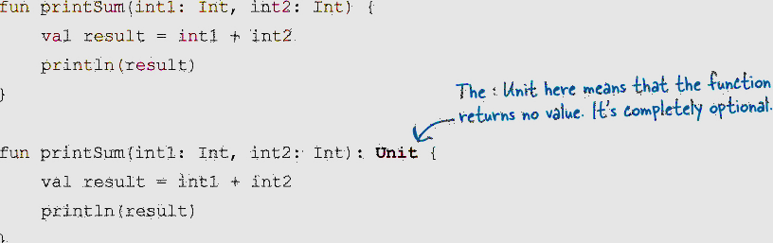
Functions
Examples of functions returning nothing

Slide 23
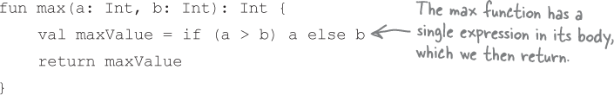

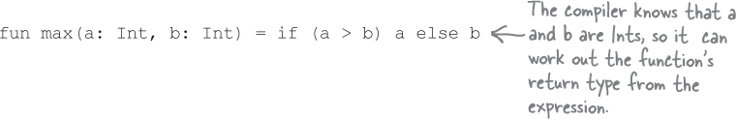
Funnctions

Slide 24
Functions
Default values
fun buildMessageFor(name: String = "Customer", count: Int = 0): String {
return("$name, you are customer number $count")
}
val message = buildMessageFor(count = 10)
If parameter names are not used, only the trailing arguments may be omitted:
val message = buildMessageFor("John") // Valid
val message = buildMessageFor(10) // Invalid

Slide 25
Functions
fun displayStrings(vararg strings: String)
{
for (string in strings) {
println(string)
}
}
displayStrings("one", "two", "three", "four")
Kotlin does not permit multiple vararg parameters within a function
All single parameters supported by the function must be declared before the vararg declaration:

Slide 26
Functions
Lambda expressions
lambdas are self-contained blocks of code
val multiply = { val1: Int, val2: Int -> val1 * val2 }
val result = multiply(10, 20)
To assign a function reference to a variable
val mavar = ::myfunction
myvar()
val result = { val1: Int, val2: Int -> val1 * val2 }(10, 20)

Slide 27
Get input from user
readline()
val userInput = readLine()
Gets a line – String
If other input types are needed change the type
Random numbers
kotlin.random.Random.nextInt() -> returns and integer
Math.random() -> 0 and 1

Slide 28
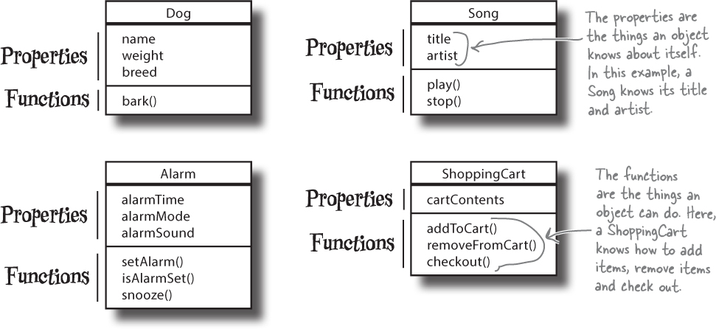
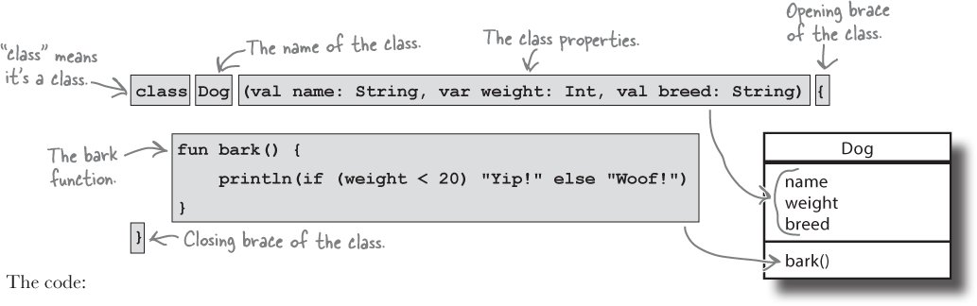
Classes and objects
Class is a template that defines what properties and functions are associated with objects of that type.
The things an object knows about itself are its properties.
The things an object can do are its functions.

Slide 29
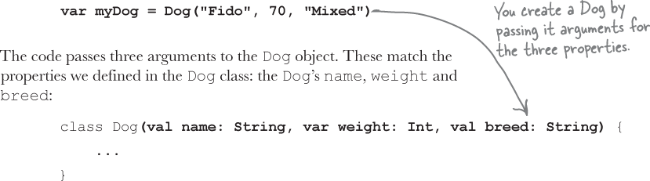
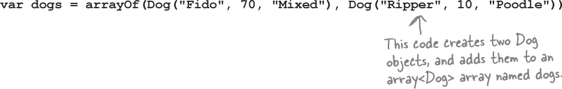

Create an object and access properties

Slide 30
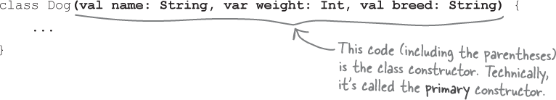
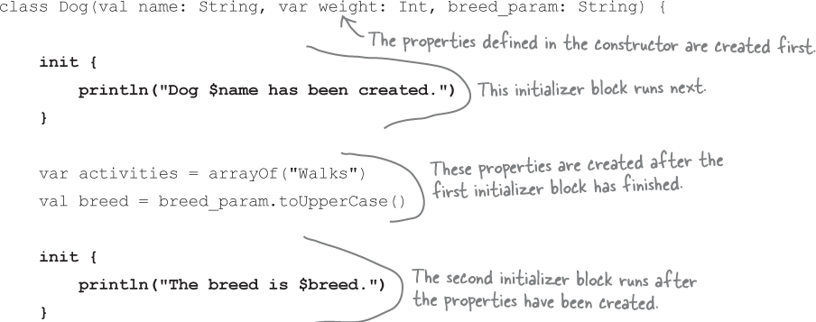
Constructor
A constructor runs when you instantiate an object. It’s used to define properties and initialize them.
If you need to initialize a property to something more complex than a simple expression, or if there’s extra code you want to run when each object is created, you can use one or more initializer blocks.
You must initialize properties before you use them
lateinit var temperament: String
If you want to initialize a variable later use lateinit

Slide 31
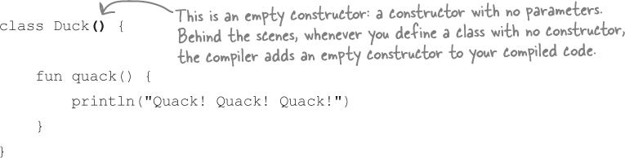
Classes and object's
You can only use lateinit with properties defined using var, and you can’t use it with any of the following types: Byte, Short, Int, Long, Double, Float, Char or Boolean.
var myDuck = Duck() ✓
var myDuck = Duck ✗

Slide 32
Superclass and subclass
A superclass contains common properties and functions that are inherited by one or more subclasses.
A subclass can include extra properties and functions and can override the things that it inherits.
If your inheritance tree is well-designed, the IS-A test should make sense when you ask any subclass if it IS-A any of its supertypes.

Slide 33
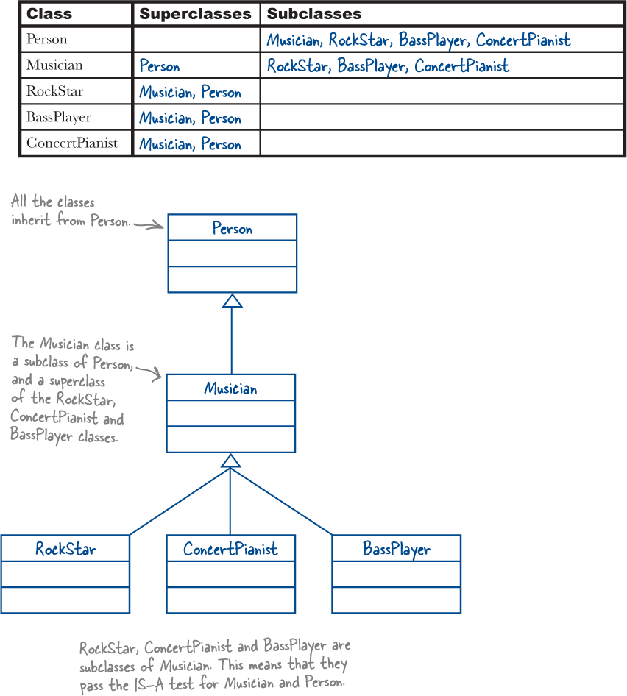

Slide 34
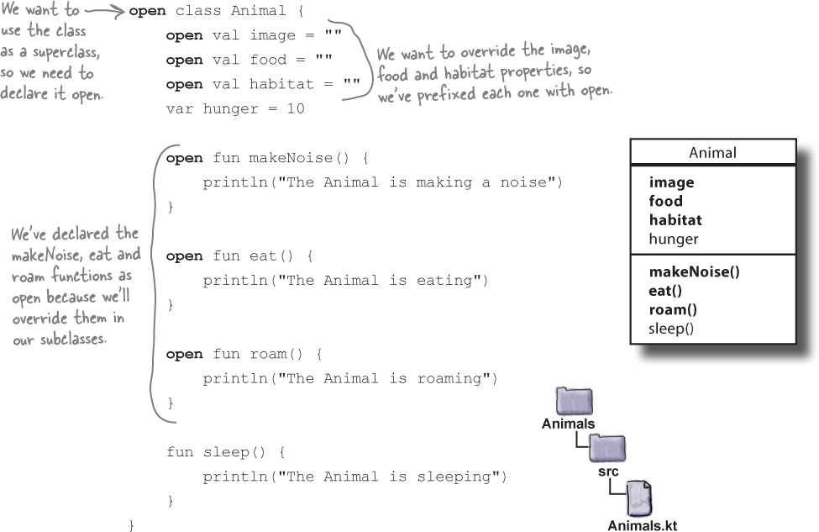
Superclass

